Slide 1
Tridium Cybersecurity Overview

Slide 2
Security Processes
Security Requirements | Based on ISA 62443-3-3 Security Level 4 for Critical Infrastructure - Protection against intentional violation using sophisticated means with extended resources, IACS specific skills and high motivation
Internal Reviews by Tridium’s Product Security Team | Security Design Reviews, Security Code Reviews Security Threat Modeling Automated Security Tests for ISA 62443-3-3 Security Requirements Reviews for vulnerabilities in third party libraries Static Code Analysis and Binary Code Analysis Risks managed in Risk Register according to CVSS Score
Reviews by External Teams | Routine and Periodic Robust Security Testing by External Organizations on new and existing releases – partnering with commercial and government entities, throughout the year Penetration Testing, Abuse Case Testing, Security Code Reviews
Reviews by Internal Security Auditor, CTO, and CCB approval | 5 Phase Process, where all security artifacts from above are reviewed, and must have CTO signoff before Tridium CCB meets to vote on each phase
Risk Management Process with Deadlines on mitigating all found threats | All known security vulnerabilities have visibility at the highest level, with 30-day, 60-day, 90-day, 120-day requirements for mitigation based on CVSS Score
Product Security Incident Response Team | Robust process for investigating vulnerabilities, mitigating threats, and communication response. Work closely with US Government re: Advisories
Support | Routinely patch potential vulnerabilities, release security update builds, and send communications to the Niagara community
Tridium’s Security Processes at a Glance
Notes:
Authentication means “securely validating” user identities, and there can be multiple authentication schemes that do this. In Niagara, we use strong digest authentication by default (SCRAM-SHA-256), but the design of Niagara is flexible with “pluggable authentication schemes”, which means that someone from the Niagara developer community can write a new approach to authentication & “plug it” in to Niagara. For example, someone could build a module for digital certificate authentication (PKI), multi-factor authentication, or the authentication scheme of your choice.
Identity Infrastructure and PKI Integration – Niagara supports a variety of different security protocols & identity infrastructure that might be deployed in customer environments. Niagara can be configured to use LDAP authentication (where multiple stations and systems are synced up to use centralized credentials in an LDAP directory) or Kerberos authentication. Niagara is also PKI enabled. by default, we ship Niagara with certificates, and Niagara also comes with certificate management tools so that you can import certificates from your organization’s trusted or third-party Certificate Authority (CA).
Role-Based Access Control – Once a user has been successfully authenticated, it’s important to control access based on what the user has permission to do. In order to accomplish this, we support the concept of providing access control based on the security roles of the authenticated user. Niagara comes with simple tools for user account management, where you create new security roles (like, for example “HVACAdministrator”), assign them certain permissions on different components of your system (ex: HVAC components), and then assign those roles to users. This makes access control easier to understand for administrators, and ultimately more secure.
Authorization at the API level – Because Niagara is a flexible framework that will allow you to use modules written by third parties in the Niagara community, it is important to make sure we control what these components can do on Niagara – we do this by using a security manager which enforces access control policy – not just for users, but also for components of the system. This protects sensitive data and restricts third party components from doing things that they shouldn’t be allowed to do.
Encryption of all communications – By default, all communications are encrypted using the Transport Layer Security (TLS) protocol. (This is for FOXS and HTTPS communications), which provides confidentiality of all data transmissions
Encryption at rest – We encrypt sensitive data on disk, providing confidentiality of sensitive data at rest.
Digitally signed code, validated at run-time. To provide assurance that the core framework cannot be tampered with, manipulated, or altered by a malicious third party, we digitally sign our code, and validate it at run-time. A product of public-key cryptography, such a digital signature ensures the integrity of our framework, and it cryptographically binds this to Tridium. What this all means is that if you are running Niagara 4, you have a high degree of assurance that our core framework has not been altered or manipulated.
JACE-8000 Secure Boot – With the JACE-8000, we also protect our boot sector and operating system from alteration and manipulation. Our boot loader validates the signature of our boot sector and main operating system image, providing further assurance that the software on the JACE-8000 has not been manipulated, altered, or compromised.
Common sense user-account management – Niagara provides a flexible framework for account management, and provides mechanisms for integrators and administrators to configure Niagara to adhere to strong security policies of any organizations, regarding password strengths, user lockouts, and many other options. Our documentation, webinars, and articles provide guidance and best practices for securing Niagara.
Auditing of All User Activity – Niagara is set up to audit user activity at levels that can be configured by administrators. This can be helpful when diagnosing problems and potentially detecting threats like brute-force login attempts.

Slide 3
Security capabilities
Authentication | Pluggable schemes provide flexibility;defaults are the most secure; Multi-Factor Authentication (MFA) now an option with Google 2 Factor Authentication; Niagara 4.8 includes digital certificate authentication (Kiosk Mode) & 802.1x device network authentication
Identity infrastructure and PKI integration | Can integrate with any PKI infrastructure,LDAP directories, Kerberos, and SAML 2 Identity Providers for Single Sign-On; Niagara 4.8 also includes 802.1x device authentication to the network; 4.9 includes SAML IDP integrated with Niagara
Role-Based Access Control | Provides access control for users by security role
Authorization at API level | Controls what individual software components can do
Encryption of all communications | All communications encrypted by default
Encryption at rest | Sensitive data is encrypted on disk
Digitally signed code, validated at run-time | Assures that core framework code can’t be altered or manipulated; In 4.9, we require 3rd party module signing by default & provide visibility to administrator
Hardware Security: JACE-8000 Secure Boot & HSM | Hardware root-of-trust; Only boots our digitally-signed trusted software, providing assurance against alteration; Also, Hardware Security Module provides hardware protection of private key for device authentication
Common-sense user account management | Configurable security mechanisms for attack prevention (lockouts, password strengths, etc.)
Auditing of all user activity | User access is logged to customized levels New for 4.9! Enhanced Security Audit Log & security facets
Security Situational Awareness | Niagara 4.8+ Security Dashboard provides an actional view into security posture of your systems & other connected Niagara systems on your network
Notes:
Authentication means “securely validating” user identities, and there can be multiple authentication schemes that do this. In Niagara, we use strong digest authentication by default (SCRAM-SHA-256), but the design of Niagara is flexible with “pluggable authentication schemes”, which means that someone from the Niagara developer community can write a new approach to authentication & “plug it” in to Niagara. For example, someone could build a module for digital certificate authentication (PKI), multi-factor authentication, or the authentication scheme of your choice.
Identity Infrastructure and PKI Integration – Niagara supports a variety of different security protocols & identity infrastructure that might be deployed in customer environments. Niagara can be configured to use LDAP authentication (where multiple stations and systems are synced up to use centralized credentials in an LDAP directory) or Kerberos authentication. Niagara is also PKI enabled. by default, we ship Niagara with certificates, and Niagara also comes with certificate management tools so that you can import certificates from your organization’s trusted or third-party Certificate Authority (CA).
Role-Based Access Control – Once a user has been successfully authenticated, it’s important to control access based on what the user has permission to do. In order to accomplish this, we support the concept of providing access control based on the security roles of the authenticated user. Niagara comes with simple tools for user account management, where you create new security roles (like, for example “HVACAdministrator”), assign them certain permissions on different components of your system (ex: HVAC components), and then assign those roles to users. This makes access control easier to understand for administrators, and ultimately more secure.
Authorization at the API level – Because Niagara is a flexible framework that will allow you to use modules written by third parties in the Niagara community, it is important to make sure we control what these components can do on Niagara – we do this by using a security manager which enforces access control policy – not just for users, but also for components of the system. This protects sensitive data and restricts third party components from doing things that they shouldn’t be allowed to do.
Encryption of all communications – By default, all communications are encrypted using the Transport Layer Security (TLS) protocol. (This is for FOXS and HTTPS communications), which provides confidentiality of all data transmissions
Encryption at rest – We encrypt sensitive data on disk, providing confidentiality of sensitive data at rest.
Digitally signed code, validated at run-time. To provide assurance that the core framework cannot be tampered with, manipulated, or altered by a malicious third party, we digitally sign our code, and validate it at run-time. A product of public-key cryptography, such a digital signature ensures the integrity of our framework, and it cryptographically binds this to Tridium. What this all means is that if you are running Niagara 4, you have a high degree of assurance that our core framework has not been altered or manipulated.
JACE-8000 Secure Boot – With the JACE-8000, we also protect our boot sector and operating system from alteration and manipulation. Our boot loader validates the signature of our boot sector and main operating system image, providing further assurance that the software on the JACE-8000 has not been manipulated, altered, or compromised.
Common sense user-account management – Niagara provides a flexible framework for account management, and provides mechanisms for integrators and administrators to configure Niagara to adhere to strong security policies of any organizations, regarding password strengths, user lockouts, and many other options. Our documentation, webinars, and articles provide guidance and best practices for securing Niagara.
Auditing of All User Activity – Niagara is set up to audit user activity at levels that can be configured by administrators. This can be helpful when diagnosing problems and potentially detecting threats like brute-force login attempts.

Slide 4
Authentication | SCRAM-SHA (256/512 bit) DIGEST – default JACE-8000: WPA-PSK128, WPA2PSK256 Google 2 Factor Auth, Client Cert Auth (Kiosk Mode); 4.9 Includes SAML Identity Provider (IDP) that can be used with SAML-based Single-Sign-On
Identity infrastructure integration | PKI, LDAP, Kerberos authentication, SAML 2 IDP SSO Integration
Encrypted communications* *(By default – only perfect forward secrecy ciphers are used) TLS 1.3 in progress. | TLS 1.2, 1.1, 1.0 (FOXS / HTTPS) Issued with RSA 2048 bit certificate, SHA256withRSA
Encryption at rest | AES 256-CBC Symmetric Key Encryption (4.9 -> AES GCM) PBKDF2-HMAC-SHA256
Digital signatures | SHA256withRSA (2048-bit RSA asymmetric key)
Compliance | 4.6+ = FIPS 140-2 Compliance, using FIPS 140-2 cryptographic module; For Federal Government, DoD Risk Management Framework (RMF) Artifacts for Niagara 4 available in SAFE
User authorization | RBAC (Role-Based Access Control)
User account management | OWASP Recommendations
General Security Requirements | All Security Requirements for Niagara derived from ISA 62443 Security Level 4
Security standards / protocols

Slide 5
Our “Secure by Default” principle
Make security easier: default to the most secure configurations
All transmissions encrypted
Users forced to have strong password strengths
Users set up with the strongest authentication mechanism
User lockouts upon consecutive bad log-ins
Force administrators to do the right thing
Factory default password must be changed after commissioning
Do the right thing, regardless of configuration
Encrypt sensitive information at rest
Digitally Signed Code: validated at run-time
JACE-8000 Secure Boot: trusted software validated at boot-time
Provide stronger configuration options based on best practices
Articles, documentation, TridiumTalks provide detailed guidance
We provide strong security capabilities – but it is important for our our partners and customers to configure and manage Niagara correctly!

Slide 6
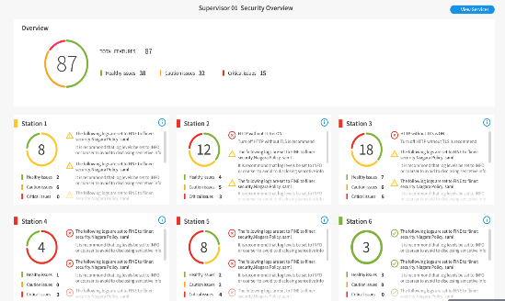
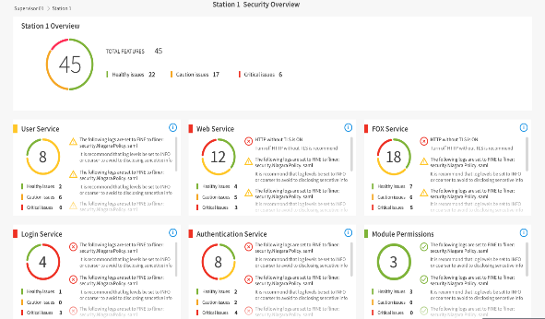
Security Dashboard in Niagara 4.8 (and Beyond)
Security Dashboard
Providing an Instant View of the Security Posture of Your Stations
… so that you can adjust your settings for the best security.
Notes:
And when you have a lot of devices, it’s important that you know their security posture.
We created a security dashboard for Niagara stations to give you visibility in how well you’re doing configuring all the security settings. The great thing here is – not only will it allow you to see what settings you might want to change based on cybersecurity best practices, but it will allow you to drill down to the configuration setting to change it.
And not only will you have this at the station level, you’ll now have this at the supervisor level, which means you will have an enterprise level view of all of your stations.

Slide 7
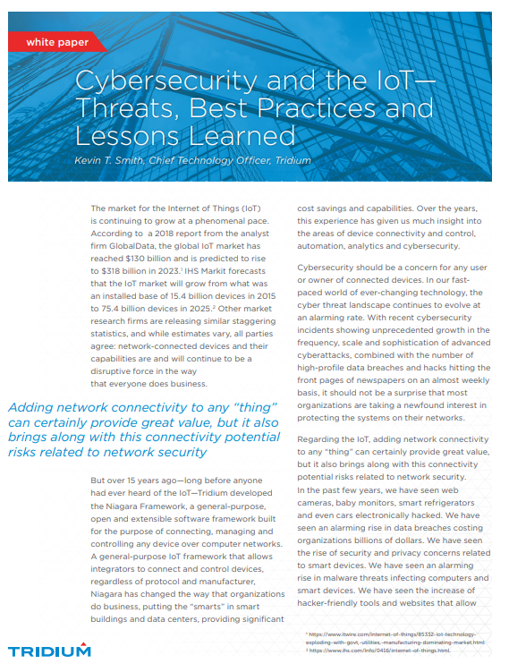
Resources
Hardening Guides & Technical bulletins
http://www.tridium.com/en/resources/library
Niagara 4 documentation
Station Security Guide (ships with Niagara)
Smith, Kevin, “After the Breach – How Can My Building Recover from a Cyberattack?”, New Deal for Buildings Article, January 2020.
Tridium White Paper, Cybersecurity and the IoT – Threats, Best Practices, and Lessons Learned, 2019.
Smith, Kevin, “Do You Know Your Building Automation System Cybersecurity Risks?”, FacilitiesNet, November 2019.
Smith, Kevin, “Reduce the Cyber Risks to Your Buildings”. AutomatedBuildings.com, September 2019.
Smith, Kevin, “Cybersecurity Considerations in Smart Buildings” (video), August 2019.
Smith, Kevin, “Towards a Cybersecurity Partnership in Connected Buildings”, Realcomm, February 2019.
Smith, Kevin, “Harden Your Buildings Against Cyber Threats” (video), October 2018.

Slide 8
Thank You! Kevin T. Smith, CISSP, CSSLP CTO ksmith@tridium.com www.linkedin.com/in/kevintsmith/

